Slide 2
Pipelining I : Introduction
CS 3339
Lecture 8a
Greg LaKomski
Texas State University
Spring 2018
*some slides adopted from P&H

Slide 3
Announcements
Will grade midterms over the weekend
Project 2 – will talk about briefly today then put up specification
Project 1due today. Most of you have submitted and I have tested and commented. If you havent submitted please do so so I can test and comment.
It is important for you to have your code working or project 2 will be non starter

Slide 4
Announcements
Had first coding club meeting. Was OK but we will continue to improve training part
I have more ethernet cables in my office. You want them, come get them

Slide 5
Today
Vote on top 5 slides
Key for me was how well they did at explaining the complexities of doing what your boss asked you do
None of the slides did something that is critical for this type of ask. Tell your boss what he asked you do! He may be surprised ☺

Slide 6
Note
Readability: What color combinations are easy to read?
Density: Too much information in words can be a problem
Font Size: Too small or some weird font is almost always a big problem. You are not an artist you are an engineer.
Always find a way to make the purpose of the slide clear to a reader since the slides may be forwarded to you bosses boss.

Slide 7
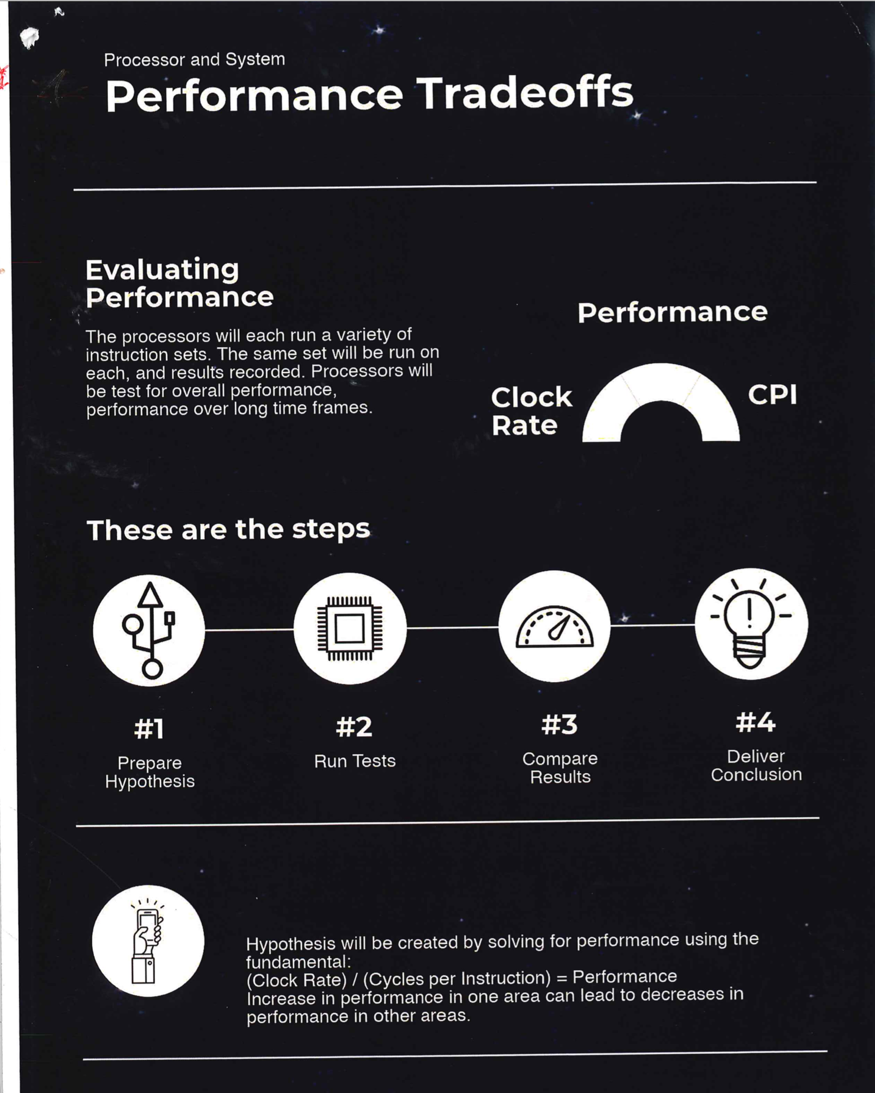
1

Slide 8
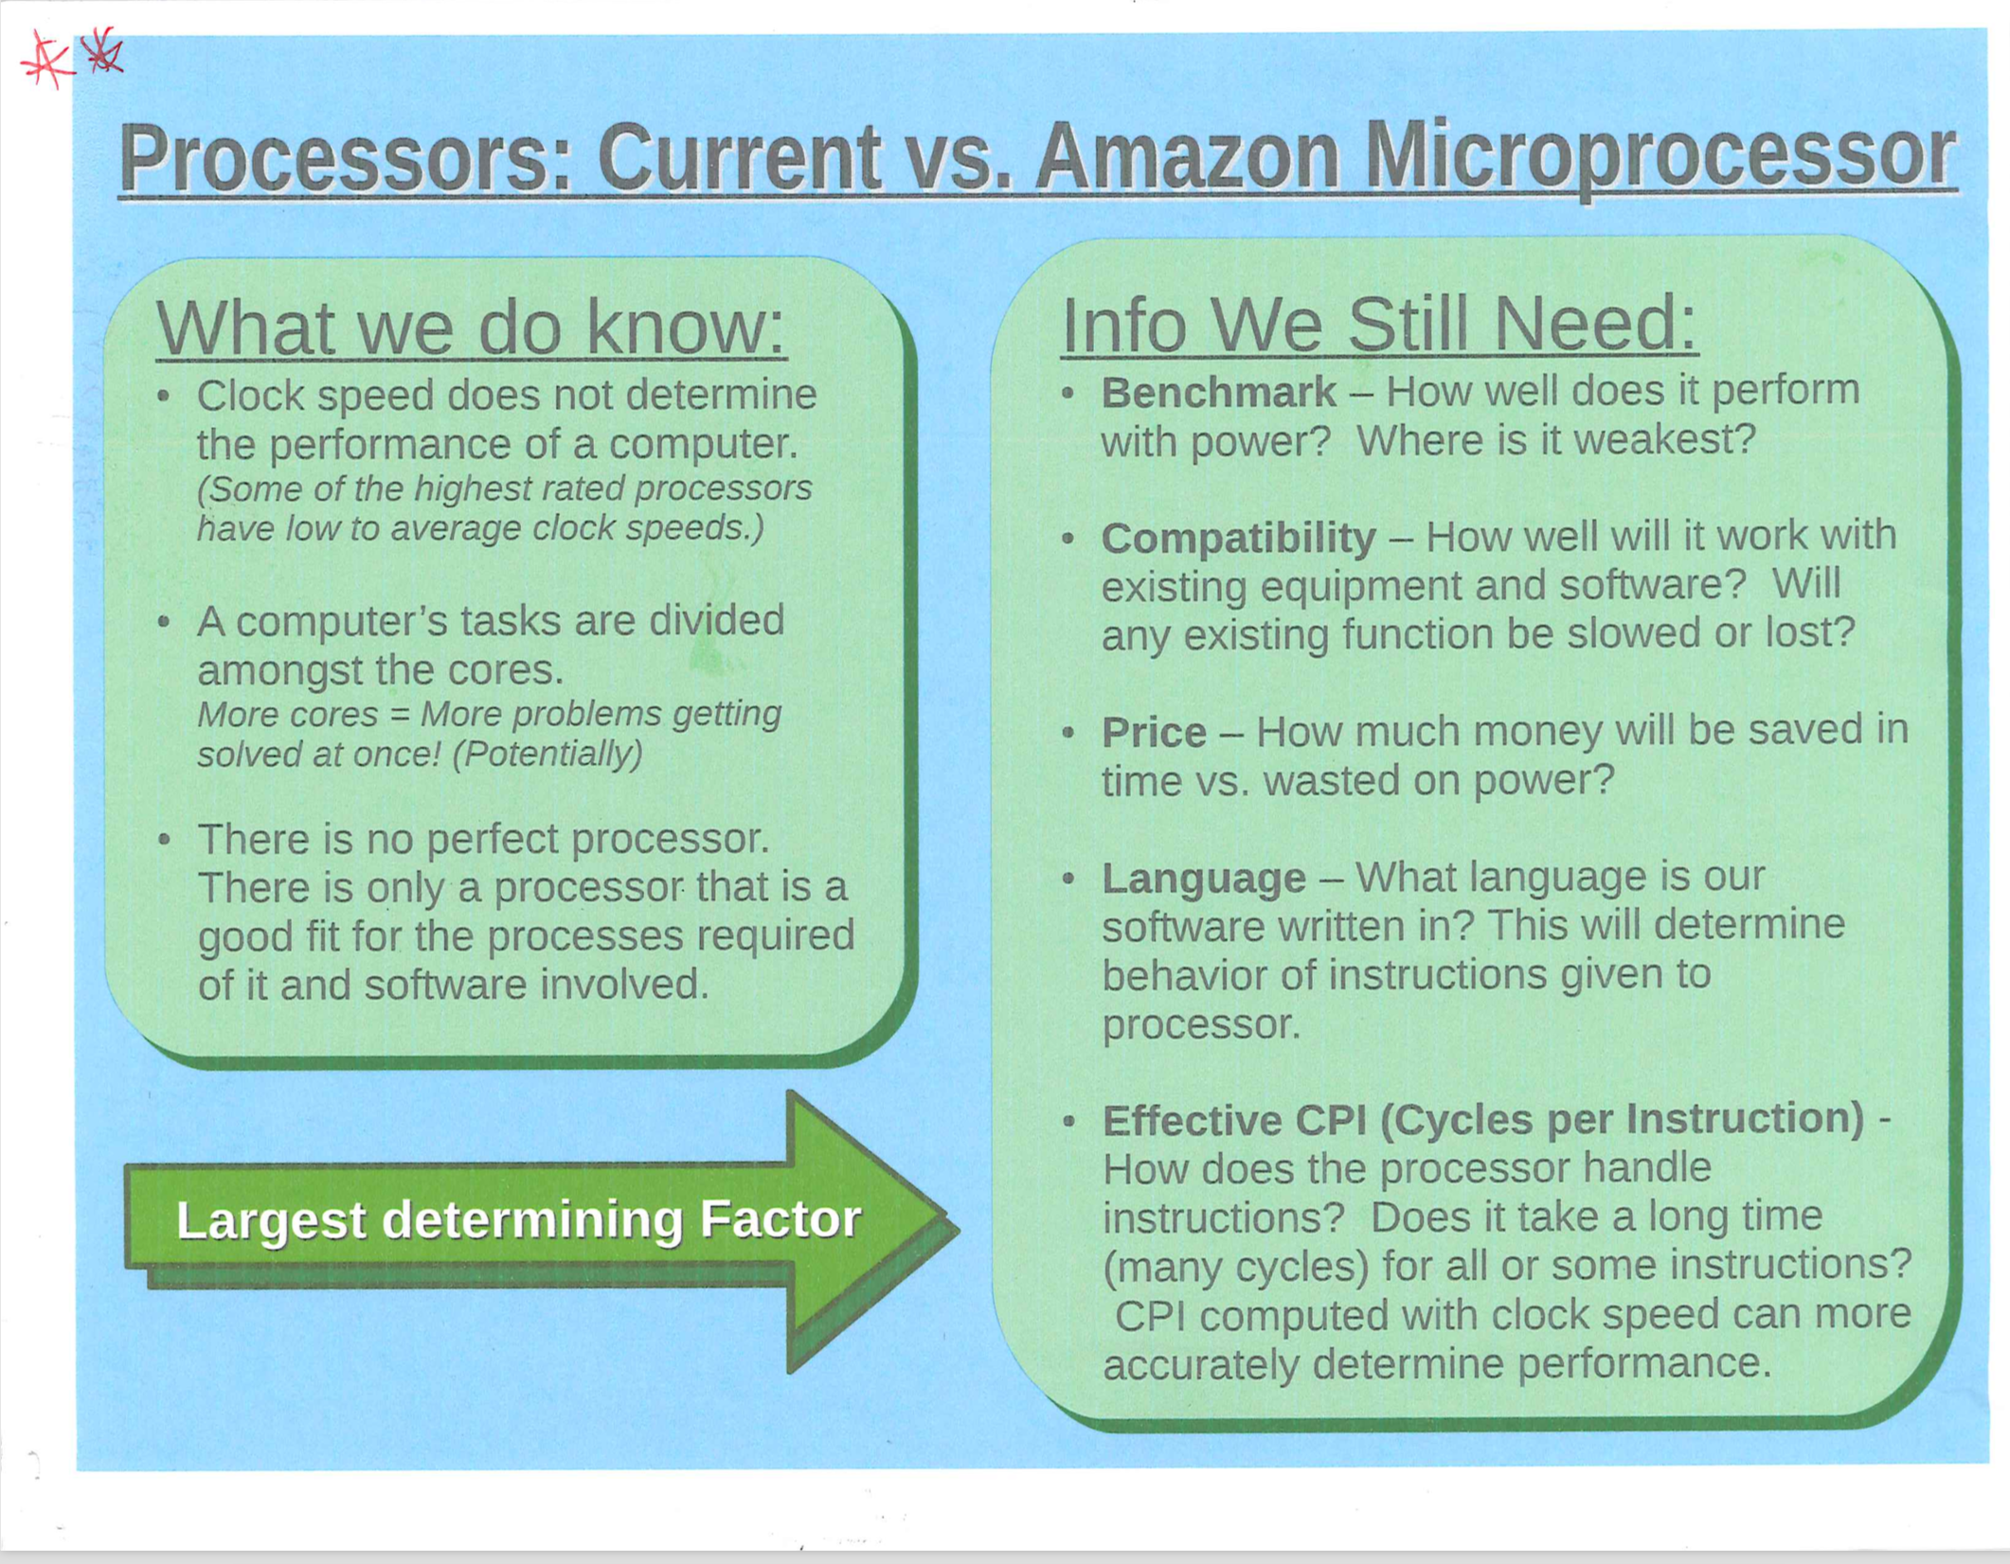
2

Slide 9
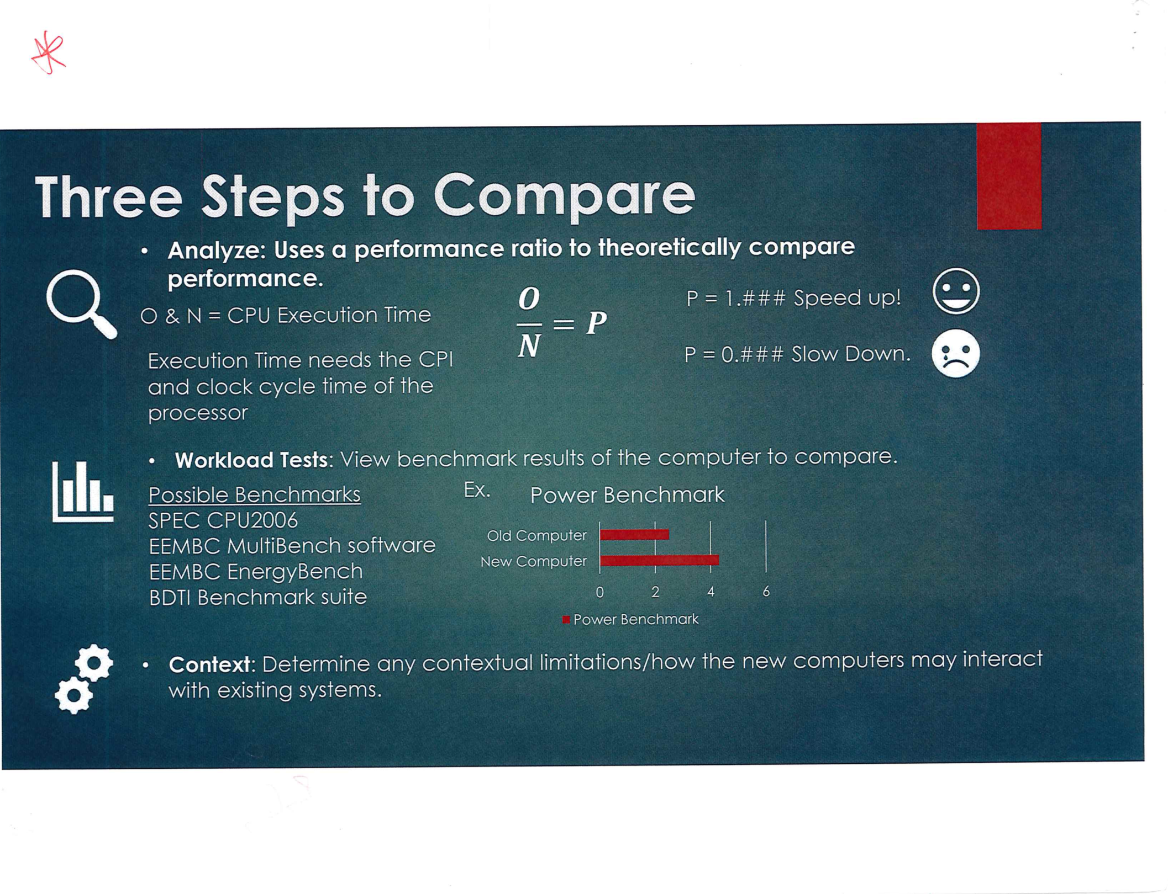
3

Slide 10
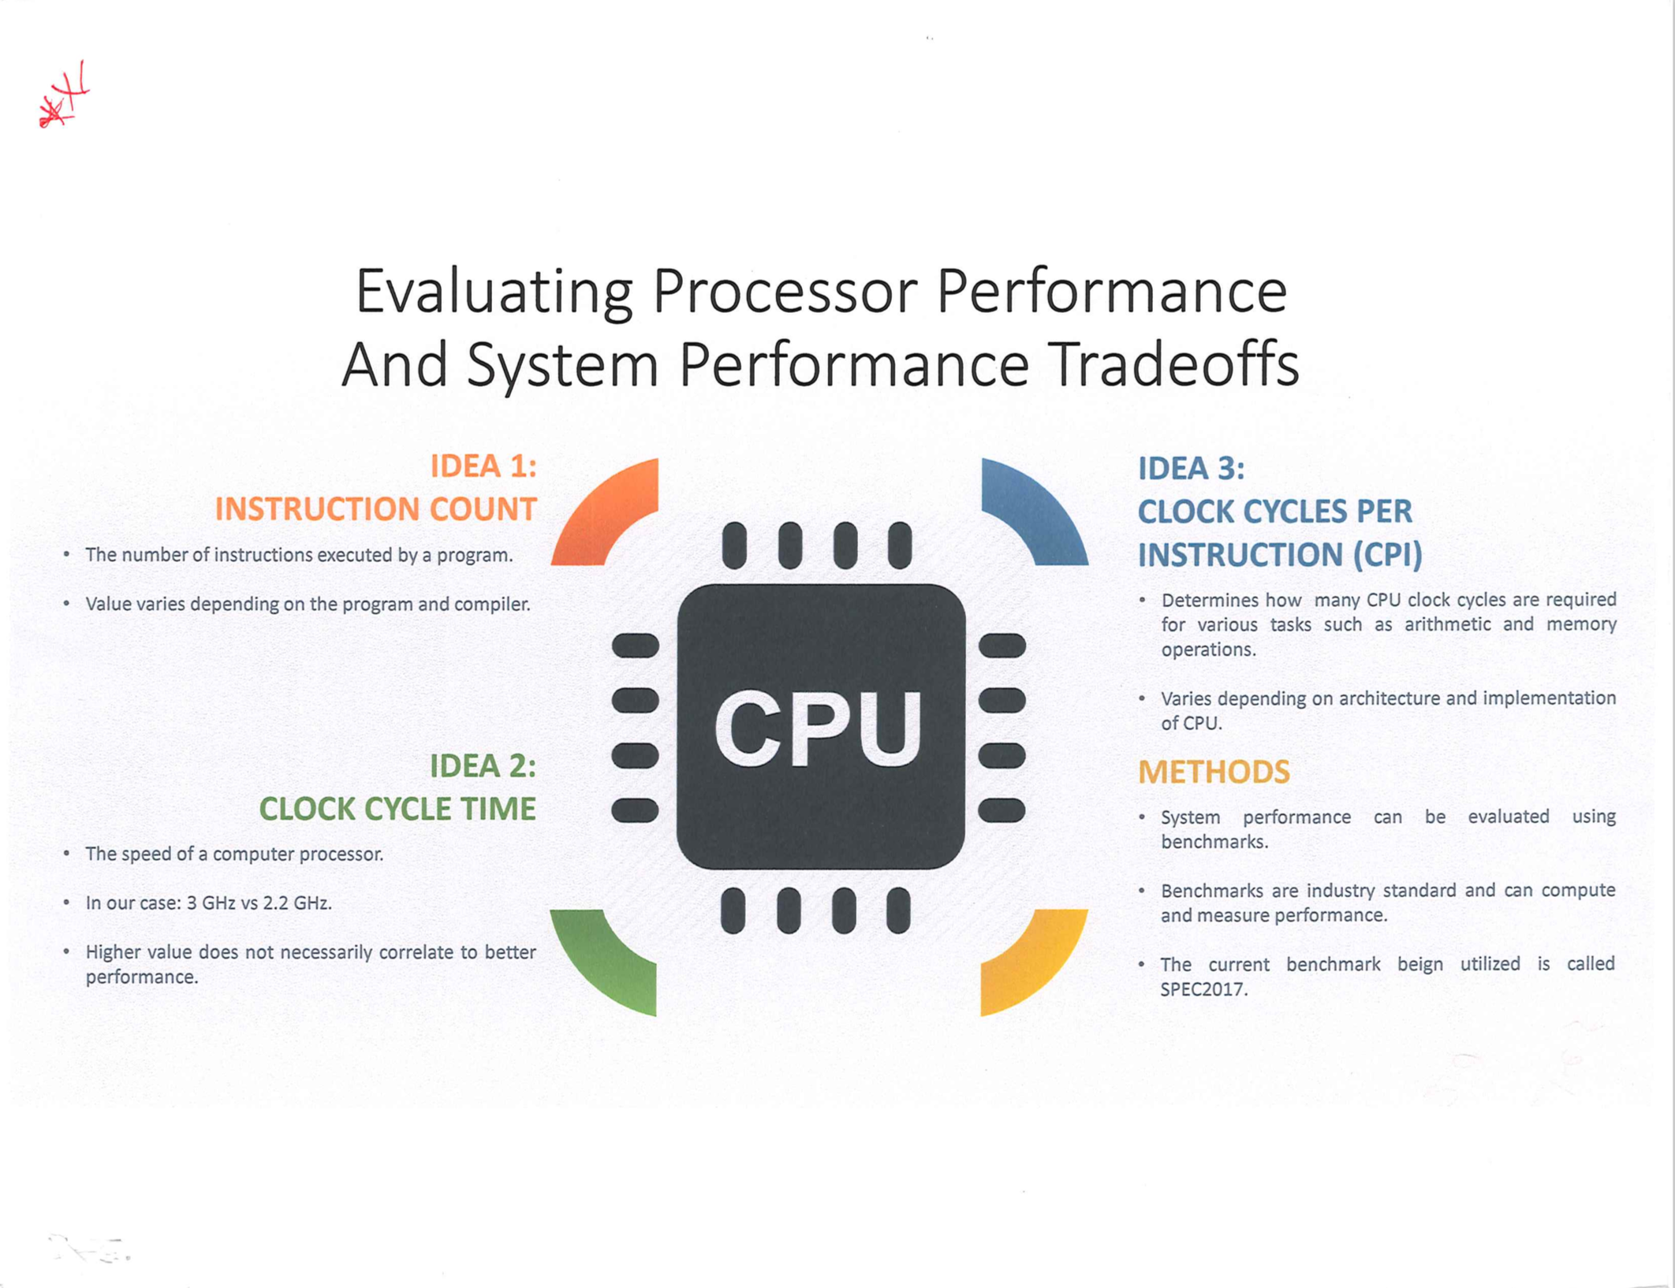
4

Slide 11
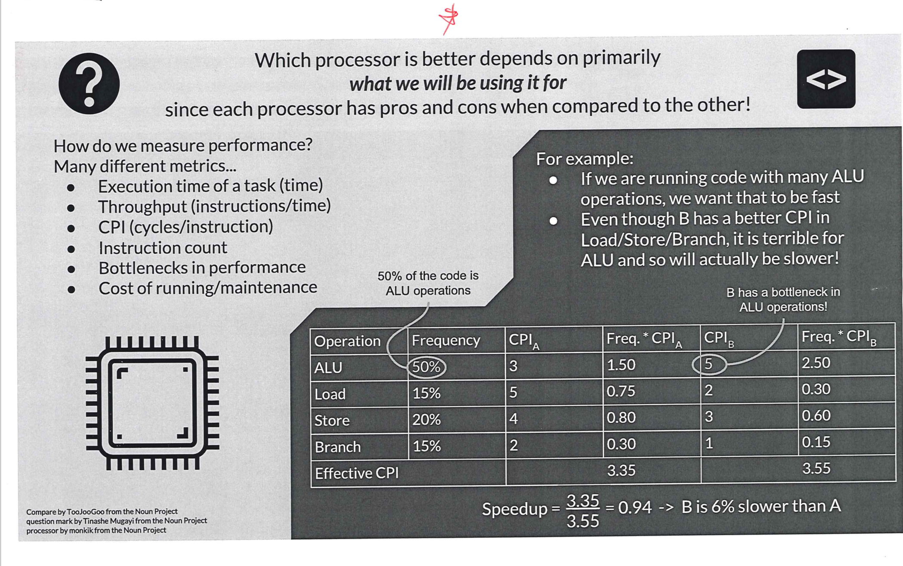
5

Slide 12

Just for fun but not a raise maker

Slide 13
Review

Slide 14
Pipelining is Natural
Alice, Bob, Cathy, Dave each have one load of clothes to wash, dry, and fold
Everyone arrives at the Laundromat at exactly the same time
Laundromat has one washer and one dryer
Washer takes 30 minutes
Dryer takes 30 minutes
Folding takes 30 minutes
A
B
C
D

Slide 15
Sequential Laundry
6 PM
7
8
9
10
11
12
T
a
s
k
O
r
d
e
r
30
30
30
30
30
30
30
30
30
30
30
30
Time
A
B
C
D
Sequential laundry takes 6 hours for 4 loads!
In reality, the laundry would get done much faster …

Slide 16
Pipelined Laundry: Start work ASAP
6 PM
7
8
9
10
11
12
1
2 AM
30
30
30
30
30
Time
T
a
s
k
O
r
d
e
r
30
30
A
B
C
D
Pipelined laundry takes 3 hours for 4 loads!

Slide 17
Laundry and Pipelined Processors
Laundry => Instruction
4 loads of laundry => 4 instructions to execute
Laundromat => Processor
Washer, Dryer => Resources : Memory, ALU, Registers
30 minutes => one cycle

Slide 18
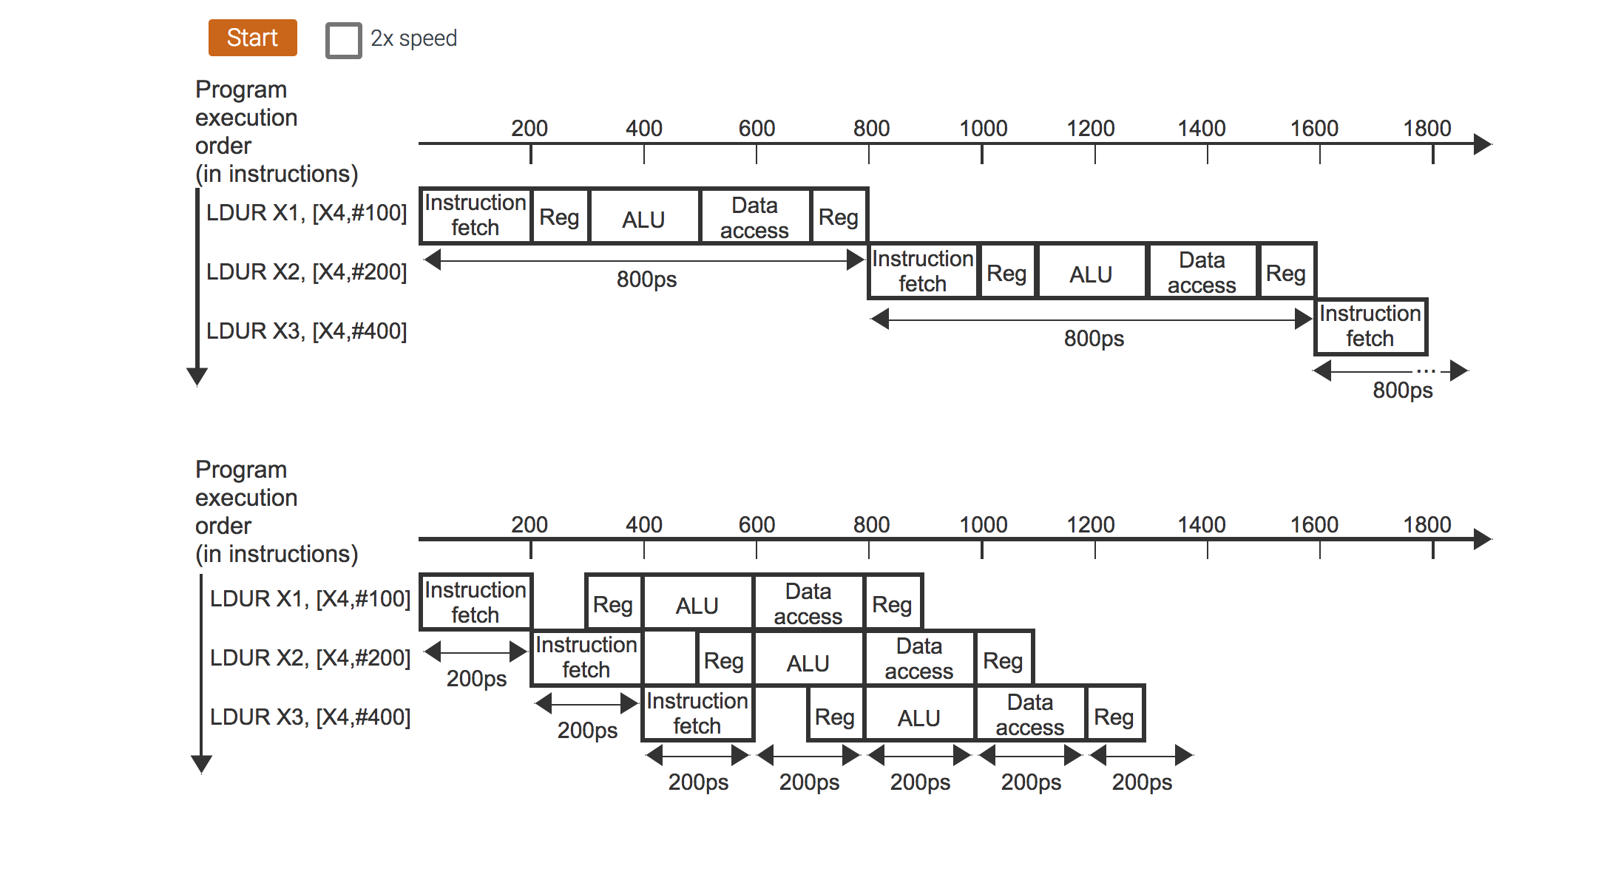
Single Cycle versus Pipelined

Slide 19

Ideal Speedup Due to Pipelining
What makes things worse than ideal??????

Slide 20
Implementing Pipelining
Questions to ask
Can we break up our task into pieces?
Yes, washing, drying, folding
What resources do we need in each part?
Washer, dryer etc.
Are there dependencies in the subtasks?
Yes, can’t dry without washing
Main idea
Break up tasks into smaller subtasks
As soon as you are done with a component task, release the resource to whatever subtask may need it next
What if there is no dependence between component tasks?

Slide 21
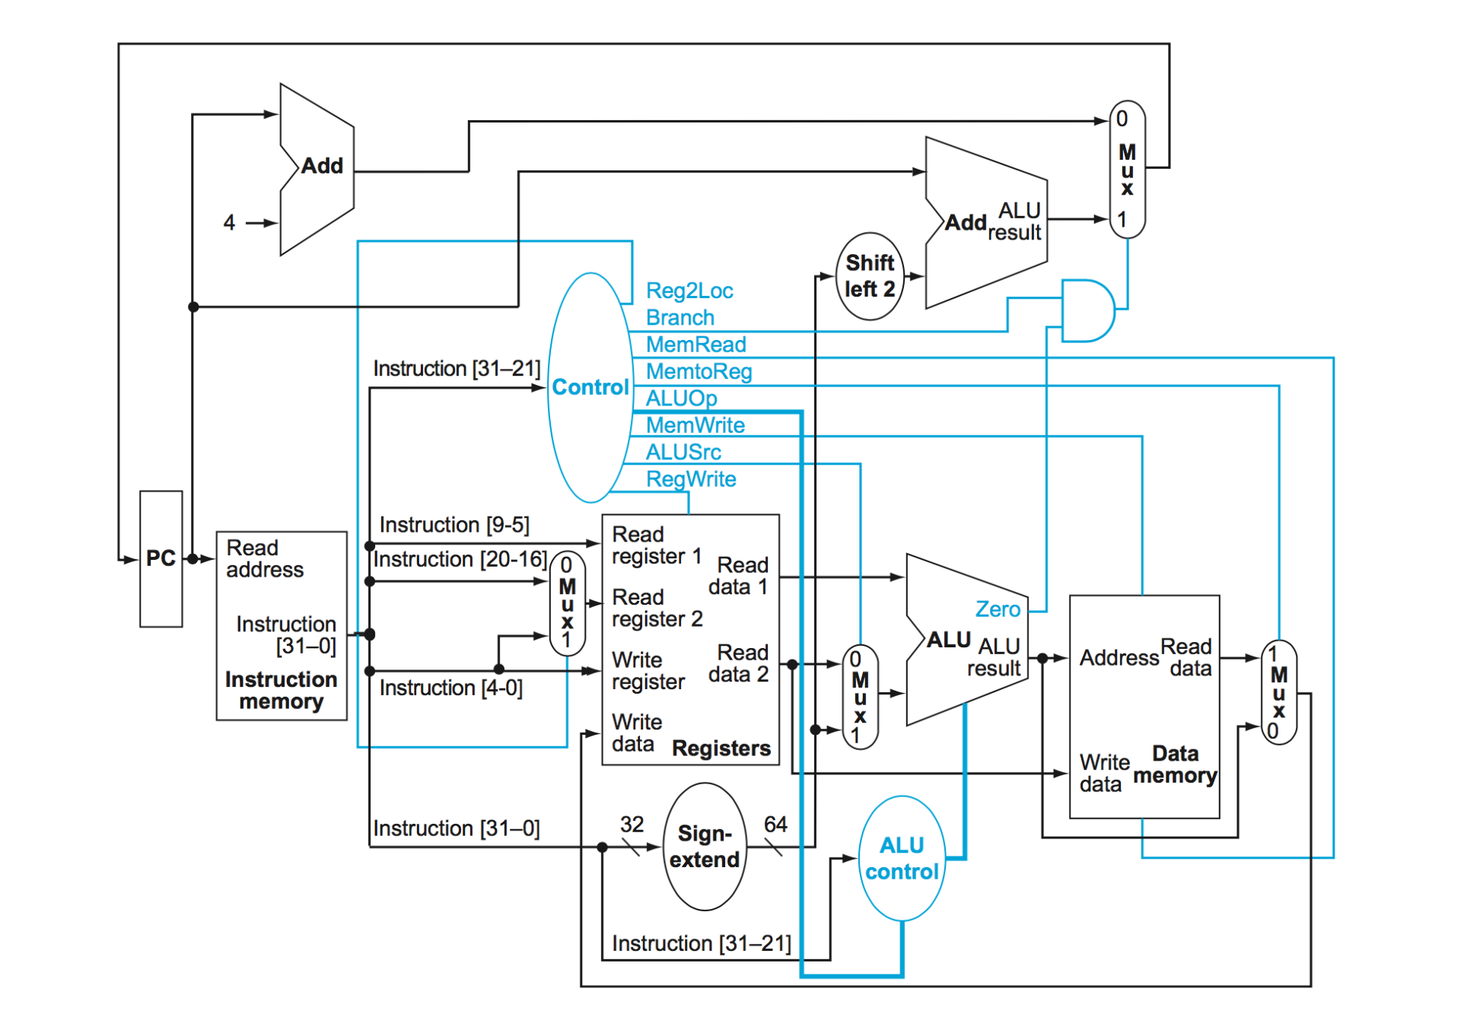
ARM Datapath – Break up tasks

Slide 22
Five Stages of the ARM Pipeline
Instruction Fetch (IF): Fetch instruction from memory and update PC
Instruction Decode (ID): Decode instructions and read from register file
Execute (EX): Execute arithmetic instruction, calculate memory address
Memory (MEM): Read/write data from/to the data memory
Write back (WB): Write result data into the register file
Don’t need all stages for every instruction
e.g., add instruction will not access data memory
Cycle 1
Cycle 2
Cycle 3
Cycle 4
Cycle 5
IF
ID
EX
MEM
WB
stash clothes without folding
Is there an instruction that’s busy in all five stages?

Slide 23
Improving Performance With Pipelining
Idea is to start the next instruction before the current one has
completed
doesn‘t give us (pure) parallelism
improves throughput
instructions per unit time, CPI
instruction latency is not reduced
Number of laundries finished in one evening increases
Alice still needs 1.5 hours to complete her laundry
Cycle 1
Cycle 2
Cycle 3
Cycle 4
Cycle 5
Cycle 6
Cycle 7
Cycle 8
lw
Fetch
Dec
Exec
Mem
WB
sw
Fetch
Dec
Exec
Mem
WB
add
Fetch
Dec
Exec
MEM
WB

Slide 24
Pipelining and Clock Cycle Time
The length of a pipeline stage equals the clock cycle time
Increased latency for some instructions
Latency is sum of all stages, even if some stages are unused (wasted cycles)
An ALU instruction that could execute in 2 cycles might need 4
Clock cycle time is limited by the slowest stage
for some stages don’t need the whole clock cycle (e.g., WB)
Cycle 1
Cycle 2
Cycle 3
Cycle 4
Cycle 5
Cycle 6
Cycle 7
Cycle 8
lw
Fetch
Dec
Exec
Mem
WB
unused
sw
Fetch
Dec
Exec
Mem
WB
add
Fetch
Dec
Exec
Mem
WB

Slide 25
Single Cycle vs. Pipelining
Single Cycle Implementation (CC = 1000 ps):
Cycle 1
Cycle 2
Clk
lw
sw
waste
Pipeline Implementation (CC = 200 ps):
lw
Fetch
Dec
Exec
Mem
WB
sw
Fetch
Dec
Exec
Mem
WB
Although there is some wastage, overall save time over single cycle

Slide 26
Pipelining in ARM v8
What makes it easy
all instructions are the same length (32 bits)
can fetch in the 1st stage and decode in the 2nd stage
few instruction formats (6) with symmetry across formats
can begin reading register file in 2nd stage
memory operations occur only in loads and stores
can use the execute stage to calculate memory addresses
each instruction writes at most one result (i.e., changes the machine state) and does it in the last few pipeline stages (MEM or WB)
operands must be aligned in memory so a single data transfer takes only one data memory access

Slide 27
TO BE CONTINUED!

Slide 28
Implementing A Pipelined Processor

Slide 29
Implementing A Pipelined Processor
Step 1 : Break-up the clock cycle time
IF:Fetch
ID:Dec
EX:Execute
MEM:
MemAccess
WB:
WriteBack
M U X
4
Register File
Shift
left 2
Data
Memory
Read Addr 1
Read
Data 1
Read Addr 2
PC
Read
Address
ALU
Read
Data
M U X
Write Addr
M U X
Address
Read
Data 2
Write Data
Write Data
Instruction
Memory
Sign
Extend
64
System Clock

Slide 30
Implementing A Pipelined Processor
Step 2: place state registers between each pipeline stage to isolate them
IF:Fetch
ID:Dec
EX:Execute
MEM:
MemAccess
WB:
WriteBack
M U X
IF/ID
ID/EX
EX/MEM
4
Register File
Shift
left 2
Data
Memory
MEM/WB
Instruction
Memory
Read Addr 1
Read
Data 1
Read Addr 2
PC
Read
Address
ALU
Read
Data
M U X
Write Addr
M U X
Address
Read
Data 2
Write Data
Write Data
Address comes from “current” instruction
Sign
Extend
64
System Clock

Slide 31
Implementing A Pipelined Processor
Step 2: place state registers between each pipeline stage to isolate them
IF:Fetch
ID:Dec
EX:Execute
MEM:
MemAccess
WB:
WriteBack
M U X
IF/ID
ID/EX
EX/MEM
4
Shift
left 2
MEM/WB
Instruction
Memory
Read Addr 1
Data
Memory
Register
File
Read
Data 1
Read Addr 2
PC
Read
Address
ALU
Read
Data
M U X
Write Addr
Read
Data 2
M U X
Address
Write Data
Write Data
Propagate write addr through each stage
Sign
Extend
64
System Clock

Slide 32
Implementing A Pipelined Processor
Step 3: adjust control signals
M U X
PCSrc
ID/EX
EX/MEM
IF/ID
Control
Add
Branch
MEM/WB
4
RegWrite
Shift
left 2
Add
Instruction
Memory
Read Addr 1
Data
Memory
Register
File
Read
Data 1
MemtoReg
Read Addr 2
PC
Read
Address
ALUSrc
Read
Data
M U X
Write Addr
ALU
Address
Read
Data 2
M U X
Write Data
Write Data
ALU
cntrl
Sign
Extend
MemRead
All control signals can be determined during decode and held in the state registers between pipeline stages
16
32
M U X
ALUOp
RegDst

Slide 33
Pipeline Control
The control bit values remain the same as the single cycle datapath
Need to set the values at every pipeline stage
When in EX stage, could be executing lw, sw, ALU or beq
IF Stage
read Instruction Memory (always asserted) and write PC (on System Clock)
PCSrc control is set
ID Stage
no optional control signals to set
 | EX Stage |  |  |  | MEM Stage |  |  | WB Stage
 | RegDst | ALUOp1 | ALUOp0 | ALUSrc | Brch | MemRead | MemWrite | RegWrite | Mem toReg
ALU | 1 | 1 | 0 | 0 | 0 | 0 | 0 | 1 | 0
LDUR | 0 | 0 | 0 | 1 | 0 | 1 | 0 | 1 | 1
STUR | X | 0 | 0 | 1 | 0 | 0 | 1 | 0 | X
CBZ | X | 0 | 1 | 0 | 1 | 0 | 0 | 0 | X

Slide 34
Graphically Representing A Pipelined Datapath
IM
Reg
ALU
DM
Reg
Label stages with resources
Some arrows are implicit
Helps us answers questions like the following
How many cycles does it take to execute this code?
What is the ALU doing during cycle 4?
Is there a hazard, why does it occur, and how can it be fixed?

Slide 35
Pipeline Diagram
time (clock cycles)
Inst 0
IM
Reg
ALU
DM
Reg
Once the pipeline is full, one instruction is completed every cycle, so CPI = 1
Inst 1
IM
Reg
ALU
DM
Reg
instructions
Inst 2
IM
Reg
ALU
DM
Reg
Inst 3
IM
Reg
ALU
DM
Reg
Inst 4
IM
Reg
ALU
DM
Reg
Time to fill the pipeline

Slide 36
Summary
All modern day processors use pipelining
Pipelining doesn’t help latency of single task, it helps throughput of entire workload
Potential speedup: a CPI of 1 and fast CC
Pipeline rate limited by slowest pipeline stage
Unbalanced pipe stages makes for inefficiencies
The time to “fill” pipeline and time to “drain” it can impact speedup for deep pipelines and short code runs
Must detect and resolve hazards
Stalling negatively affects CPI (makes CPI less than the ideal of 1)

